Slide 1


FINANCIAL NEWS ENTITY EXTRACTION

Slide 2
Group Members
Supriya
Y.Dedeepya
Y.Sahithi
P.Evangeline
Tasneem

Slide 3
Problem statement
Financial news contains large volumes of unstructured text. Manually identifying key entities such as companies, currencies, stock tickers, and financial events is slow and inconsistent.
Objectives
To develop an automated NER system for financial news articles.
To accurately extract key entities such as companies, tickers, currencies, and financial events.
To train and evaluate the model using financial-domain datasets like FiNER.
To generate structured outputs that support financial analysis and decision-making.

Slide 4
Proposed solution
Develop an automated Financial News NER system that processes news articles, identifies domain-specific entities, and outputs structured information. The system will use machine learning or deep learning models trained on financial datasets like FiNER to ensure high accuracy and domain relevance.
Workflow
Preprocess Data – Collect and clean financial news text.
Train Model – Use FiNER/custom data to train the NER model.
Extract Entities – Identify companies, tickers, currencies, and events.
Output Results – Generate structured results for analysis.

Slide 5

Dataset
FiNER-139 Dataset – A financial-domain NER dataset containing annotated news articles.
Includes labels such as companies, stock tickers, financial events, currencies, and economic terms.
Methodology
Data Preparation – Clean text, tokenize, and format for NER training.
Model Training – Train a machine learning or deep learning NER model using financial datasets.
Entity Extraction – Apply the model to new financial news to detect key entities.
Result Generation – Output extracted entities in structured form (tables/JSON).

Slide 6

Technology used
Python for data processing and model development
NLTK / spaCy for text preprocessing
Scikit-learn / TensorFlow / PyTorch for NER model training
Pandas & NumPy for data handling
Jupyter/Colab for experimentation and testing

Slide 7
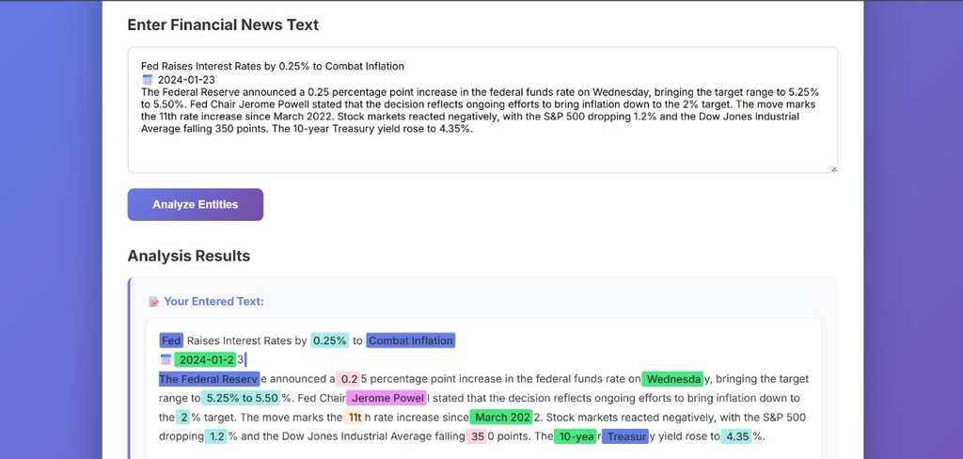
Results & Findings
The NER model successfully extracted key financial entities such as companies, tickers, currencies, and financial events.
Achieved high accuracy and consistent entity detection on financial news articles.
Model performed better on domain-specific data (FiNER-139) compared to general datasets.
Structured outputs (tables/JSON) improved readability and supported faster financial analysis.

Slide 8
Conclusion
Future Scope
Integrate real-time financial news for live entity extraction.
Expand to additional entity types like sentiment and market movements.
Deploy as a web or API-based tool for broader accessibility.
Enhance accuracy using advanced transformer models (BERT/FinBERT).
The project successfully built an NER system that accurately extracts key financial entities from news articles.
Using domain-specific data improved model performance and reliability.
The system helps transform unstructured financial text into structured insights for faster decision-making.

Slide 9
THANK YOU

